Slide 1
Making Our CASE: Catalyzing Advocacy in Science and Engineering
IMAGES ARE FROM AAAS (or pictures that I took myself)
Jennifer Haick (jehaick@luc.edu)
5th year PhD Candidate
January 12, 2016
Graduate Student Council Seminar Series

Slide 2
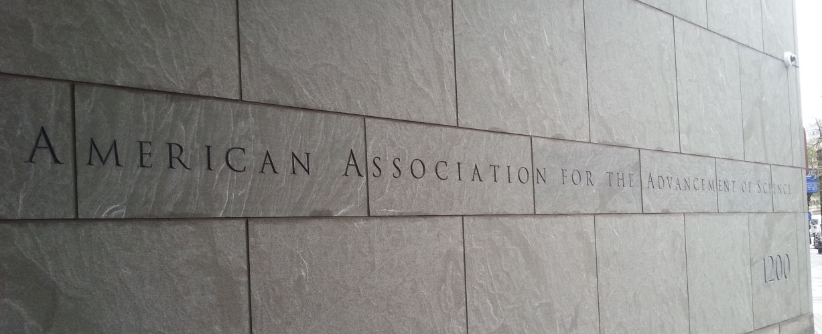
Making Our CASE Workshop
Hosted by the American Association of the Advancement of Science
April 2015 in Washington, D.C.
~100 scientists, mostly graduate students
2 days of workshops, 1 day to meet with members of Congress and their staffers on Capitol Hill

Slide 3
Introduction to Science & Technology Policy
Policy for Science: how to fund or structure the pursuit of knowledge
Science for Policy: use of knowledge to assist or improve decision making
Can be complicated to understand
Multiple agencies with unique cultures and missions are overseen by multiple congressional committees
Policy can be made at multiple levels (President, Congress, Agency)

Slide 4
Introduction to Science & Technology Policy
Understanding and/or participating in science policy is important
With a few exceptions, policy makers do not come from a science background
Science is difficult to predict and the value may not be immediately known
We need to be advocates (but I’ll get to that later…)
Careers in science policy can vary, but they largely involve acting as a bridge between scientists and the public/policy makers
Communication!

Slide 5
Introduction to the Federal Budget Process
It's useful to think of the federal budget cycle in four phases
Congressional appropriations cycle
President’s budget formulation
Phase 4: Execution of the fiscal year’s budget by agencies; begins Oct of FY
PHASE 1: Agencies and their offices receive guidance from OMB/OSTP (based on the President’s policy preferences) and develop strategic plans, identify priorities and goals, and estimate resources necessary
Budget justifications delivered to OMB

Slide 6
Introduction to the Federal Budget Process
It's useful to think of the federal budget cycle in four phases
Congressional appropriations cycle
President’s budget formulation
Phase 4: Execution of the fiscal year’s budget by agencies; begins Oct of FY
PHASE 2: OMB thoroughly reviews requests, decides what the Administration will and will not support, and notifies agencies (“passbacks”)
Agencies accept or appeal
President submits budget to congress

Slide 7
Introduction to the Federal Budget Process
It's useful to think of the federal budget cycle in four phases
Congressional appropriations cycle
President’s budget formulation
Phase 4: Execution of the fiscal year’s budget by agencies; begins Oct of FY
PHASE 3: Congress must pass a budget resolution to set framework
12 Appropriations Subcommittees hold hearings, write and eventually pass a spending bill
Appropriations Committee passes each spending bill, full chamber amends and approves (House & Senate)
A conference committee will work out the differences between the two versions and send a completed bill to the President

Slide 8
Introduction to the Federal Budget Process
It's useful to think of the federal budget cycle in four phases
Congressional appropriations cycle
President’s budget formulation
Phase 4: Execution of the fiscal year’s budget by agencies; begins Oct of FY
Note: This is “regular order” and it hasn’t happened since… 1996!
If the 12 spending bills are not completed, a continuing resolution must be passed to avoid government shutdown until appropriations pass. Funding levels from the previous year are extended, however changes can be made targeting specific programs (“anomalies”). Sometimes multiple continuing resolutions are required.

Slide 9
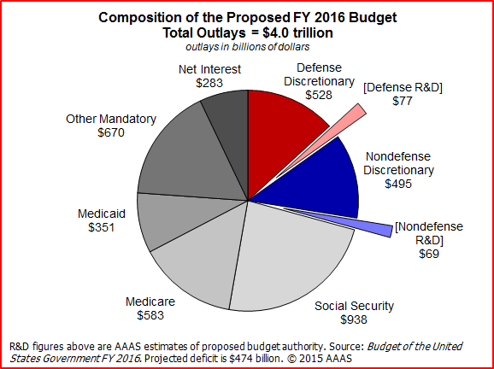
Introduction to the Federal Budget Process
99% of the budget to fund science falls within discretionary funding
Decided by Congress through the appropriations process
Good news for FY2016 (omnibus bill passed at the end of December)
Funding for science increased across the board

Slide 10
FY2016 Science Funding Increases

Slide 11
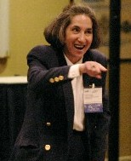
Congress: Structure and Processes
Judy Schneider
National treasure!
Specialist on Congress, Government and Finance Division, Congressional Research Service, Library of Congress
Meets with new members of Congress for crash course orientation prior to taking office
Congress is not driven by policy alone
Politics – who the players are, more than the party
Procedure – how the institution operates
Youngest congress in recent history, most of whom have not seen “regular order”
1 chemist, 1 microbiology, 1 physicist, 1 mathematician, 8 engineers, 25 medical degrees, 213 law degrees

Slide 12
Congress: Structure and Processes
Senate
Each state gets two representatives
Mostly driven by politics
Seniority is a major factor in committee assignments, however party control is often irrelevant
Unanimous consent can speed procedures along, but a Senator can talk about whatever they want as long as they want (in most cases)
House of Representatives
Number of representatives per state is based on the state’s population
Mostly driven by procedure
Majority vote needed to bring bill to floor
Committee on Rules set specific guidelines for hearings, House members must adhere to rules

Slide 13
Congress: Structure and Processes
Each branch has committees
Consider, shape and pass//Accept, analyze, amend and pass legislation
Standing committees
Assigned bills, hold hearings about bills, most bills die in committee
Select committees
Temporary, for a specific purpose
More for an investigation, don’t always draft legislation
Joint committees
Similar to select committees, but members from House and Senate
Conference committees
Created when the House and Senate need to reconcile different versions of the same bill

Slide 14
Appropriation Subcommittees for Science
Energy and Water
Department of Energy
Forest Service (USDA)
Homeland Security
Department of Homeland Security
Interior and Environment
Department of Interior –
U.S. Fish and Wildlife Service
U.S. Geologic Survey
Environmental Protection Agency
Labor, HHS, Education
Department of Education
Department of Health and Human Services
National Institutes of Health
Center for Disease Control and Prevention
Agriculture
U.S. Department of Agriculture
Commerce, Justice, Science
National Aeronautics and Space Administration
Department of Commerce –
National Institutes of Standards and Technology
National Oceanic and Atmospheric Administration
National Science Foundation
Office of Science and Technology Policy
Defense
Defense Department (military)
Defense Advanced Research Projects Agency

Slide 15
Advocacy!

Slide 16
Science Advocacy is Important!
We have a responsibility to communicate the science to the public!
Build trust while gaining awareness of public perceptions
Get others excited about science
Brings meaning to your work
AAAS.org/communicatingscience

Slide 17
Some things to keep in mind…
Miniature, Memorable, Meaningful
Start a dialogue – don’t lecture!
Avoid jargon (http://xkcd.com/1133/)
Keep the perspectives of your audience in mind
There are different styles of communication
Background
Supporting Detail
Conclusion
RESEARCHER
Bottom Line
So what?
Supporting Detail
PUBLIC

Slide 18
How to contact your representatives:
House.gov – Look up your representative(s)
Direct link to member’s website, office phone number, committees
ASBMB – Advocacy Tool Kit
Letter templates, tips/scripts for phone calls and meetings
“Unlimited Potential, Vanishing Opportunity” report
FASEB – Government and Policy Affairs – Become an Advocate
Science policy issues, funding factsheets
Washington update emails

Slide 19
Meet with your representatives:
Preparedness, Precise, Punctual
Before:
Research who you are meeting with
Committees, voting records, science advocacy history
Prepare what you are going to say ahead of time
1 minute and 5 minute versions
Summary sheet (important points, be concise!)
After:
Follow up in a timely manner!!
Thank you
Be concise
Offer to be used as a resource

Slide 20
Some things to talk about/key phrases:
Predictable and sustained funding for federal research and development in FY 2017/18/19
Personalize the story – how is the matter affecting you and the representative’s constituents (all politics is local, anecdote)
Delays in funding slow/halt research; promising project abandoned
Federal investment in young scientists
Budget cuts force people to abandon scientific and academic careers – not getting a return on the investment

Slide 21
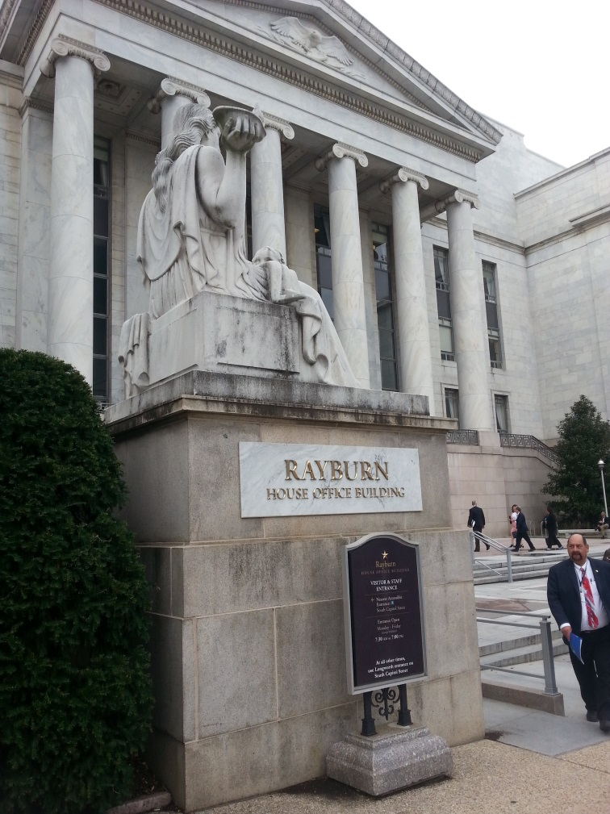
My Experiences
Met with:
Congressman Peter Roskam
Congressman Danny Davis’s Deputy Chief of Staff
Senator Mark Kirk’s Legislative Council
Congressman Randy Hultgren
Congressman Bill Foster’s Scheduler
Seemed receptive to our message
Most interested in:
How it affects me personally, Loyola, other young scientists
Investment – no return statement

Slide 22
Where to learn more:
Congress App
What’s happening on a day-to-day or bill-to-bill basis?
FASEB – Government and Policy Affairs
Science policy issues, funding factsheets
Washington update emails
AAAS – R&D Budget and Policy
Budget 101, appropriations
Sci on the Fly (AAAS fellow science policy blog)
Societies (ASBMB, ASPET, etc.) have policy/government relations/advocacy websites and offices
Policy workshops and Hill Days

Slide 23
Thank you! Questions?

